Slide 1

Web Development with Python/Django
How The Web Works
Dr. Abdelhameed Ibrahim
Assoc. Prof. of Computer Engineering

Slide 2
Django Bootcamp
This training will discuss the following:
How the web works
What do we mean by “Full-Stack”
A brief overview of the training tech
Why we chose Django for the training
2

Slide 3
Django Bootcamp
Before we can begin to learn about all the technologies in this training, we need to understand how the web works and what constitutes the “Full-Stack”
3

Slide 4
Django Bootcamp
So what happens when your at home and you open up your browser and visit a website?
Let’s breakdown the basic steps!
4

Slide 5

Django Bootcamp
You start off by typing the URL into your browser.
www.abc.com
5

Slide 6
Django Bootcamp
Your computer then sends this request as a packet, which includes the IP address of the website you want.
123.456.789.10
www.abc.com
6

Slide 7
Django Bootcamp
It sends this request through wires, or a satellite which eventually links to wires using your ISP.
123.456.789.10
www.abc.com
7

Slide 8
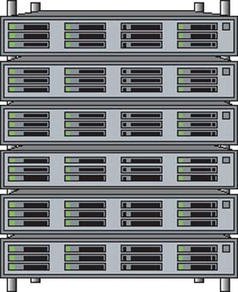
Django Bootcamp
Your ISP will then re-route the request to the appropriate server location, using the IP address as the guide.
123.456.789.10
www.abc.com
8

Slide 9
Django Bootcamp
Once your request reaches the server, it can send back the website you asked for.
www.abc.com
123.456.789.10
9

Slide 10
Django Bootcamp
However a full website with content is too big to send as a single packet of data.
www.abc.com
10

Slide 11
Django Bootcamp
To solve this, the server sends back the website split up into many packets
www.abc.com
11

Slide 12
Django Bootcamp
The packets come with instructions on how to get back to you and reassemble once they reach you.
www.abc.com
Home IP Address
12

Slide 13
Django Bootcamp
Once the packets reach you, they are reassembled to show the page.
Home IP Address
13

Slide 14
Django Bootcamp
There are two main components of a website
The Front-End
The Back-End
14

Slide 15
Django Bootcamp
The Front-End is what you see as a user on the website.
The Back-End is the technology used to actually decide what to show you on the Front-End.
15

Slide 16
Django Bootcamp
The Front-End revolves around three technologies:
HTML
CSS
Javascript
Bootstrap
16

Slide 17
Django Bootcamp
HTML - HyperText Markup language
Every website will have HTML, it is the structure of a page.
You can view it by right-clicking and selecting “View Page Source”
17

Slide 18
Django Bootcamp
CSS - Cascading Style Sheets
CSS is the actual styling of the website.
Colors, fonts, borders, etc is all defined by CSS.
CSS is not mandatory, but almost all sites have it.
18

Slide 19
Django Bootcamp
Javascript allows you to add interactivity to the website, including programming logic.
Any site with interactivity uses Javascript in some way, otherwise the site is “static”.
19

Slide 20
Django Bootcamp
The Back-End of a site has three components:
The Language
The Framework
The Database
20

Slide 21
Django Bootcamp
Our training Back-End uses:
Python as the language
Django as the Framework
SQLite as the Database
21

Slide 22
Django Bootcamp
Python is a great language to learn, it’s simple, powerful, and has many libraries.
Django is the most popular framework for Python, it’s fast, secure, and scalable.
SQLite comes with Django and Python making it an easy choice.
22

Slide 23

Github
You can download the sources in this Training from my GitHub account:
https://github.com/afai79/Django-Python
23

Slide 24
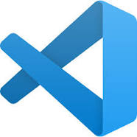
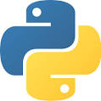

Thanks
Dr. Abdelhameed Fawzy

